Slide 1
A web-based system for data integration and statistical shape analysis in TMJ OA
Presented by: Juan Carlos Prieto
Collaborators: Lucia Cevidanes, Clément Mirabel, Priscille de Dumast, Chao Huang

Slide 2
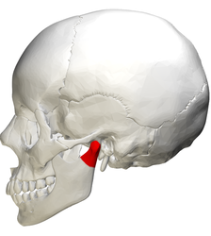
Introduction
Temporomandibular Joint Osteoarthritis (TMJ OA):
OA affects 15% of adults
Complex pathogenesis.
Symptoms are different from patient to patient.
Pain, limited jaw movement, grinding, clicking.
May repair and adapt or go into aggressive bone destruction.
Notes:
Different patterns of bone resorption and formation.
May repair and adapt or go into aggressive bone destruction.
Including pain, limited jaw movement, grinding, clicking, and deviation on opening.

Slide 3
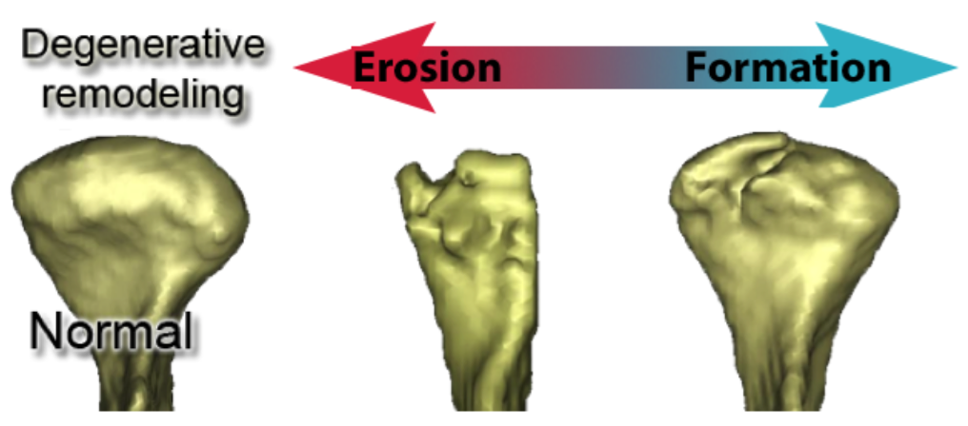
Introduction
No disease-modifying therapy exists for OA.
A biomarker is needed
Signal morphological and pathological changes.
Usable in earliest stages of OA throughout the course of the disease.
Disease treatment focused on pain management.
Notes:
The orofacial pain specialist is familiar with the different presentations of osteoarthritis and can coordinate the different specialties necessary to manage the problem.
Diverse specialties of rheumatology, orofacial pain, physical therapy, and psychology
With the advent of new scientific and clinical knowledge, we are entering a new era of increased awareness, improved care, and improved quality of life for people afflicted with OA.

Slide 4
Materials
3D Surface representation for 293 condyles (105 Control and 154 with diagnosis of TMJ OA)
Cone Beam Computed Tomography (CBCT)
0.08 mm isotropic voxel size, 4cm x 4cm field of view scan using the 3D Accuitomo 170, Morita Corp.
Saliva samples
3 ml or 15 min maximum.
Aliquoted to exactly 2 ml and an inhibitor protease (Aprotinin + PMSF) was added.
Blood samples
4 ml
Cells removed from plasma by centrifugation
Saliva and serum samples evaluation
Quantibody protein microarrays RayBiotech (Norcross, GA)
17 biomarkers were expressed
Notes:
The biomarkers chosen were known to be associated with bone repair and degradation, inflammation or nociception, common processes seen in OA. Preprocessing steps for these samples were completed at the School of Dentistry and then shipped to RayBiotech for analysis. All samples were evaluated in duplicate for level of proteins 6ckine, ANG, BDNF, CXCL16, ENA-78, GM-CSF, IFNγ, IL-1α, IL-6, MMP-3, MMP-7, PAI-1, TGFβ1, TIMP-1, TNFα, VE-Cadherin and VEGF.

Slide 5
Objectives
The goal of this work is to develop a noninvasive technique to provide information about bony changes and disease changing in TMJ OA
Integrate Heterogeneous data sources
Shape Variation Analyzer:
Classify condyles by the severity of the shape changes using deep neural networks.
Multivariate Functional Shape Data Analysis
Build association between multivariate shape measurements and demographic information
Notes:
Given the complexity of such heterogeneous conditions and current clinical, biological and imaging data in arthritis of the temporomandibular joint, there is a compelling need for more efficient software tools to facilitate these analyses.
Recent studies have demonstrated the difficulties to replicate scientific findings and/or experiments published in past.1
To answer this challenge, we developed Shape Variation Analyzer (SVA) using a neural network to classify morphological variations using 3D models of the mandibular condyle.
The effects seen in the replicated experiments were smaller than previously reported. Some of the explanations for these findings include the complexity of the experimental design and the pressure on researches to report positive findings.
The International Committee of Medical Journal Editors (ICMJE) suggests that every study considered for publication must submit a plan to share the de-identified patient data no later than 6 months after publication.
There is a growing demand to enhance the management of clinical data, facilitate data sharing across institutions and also to keep track of the data from previous experiments.

Slide 6
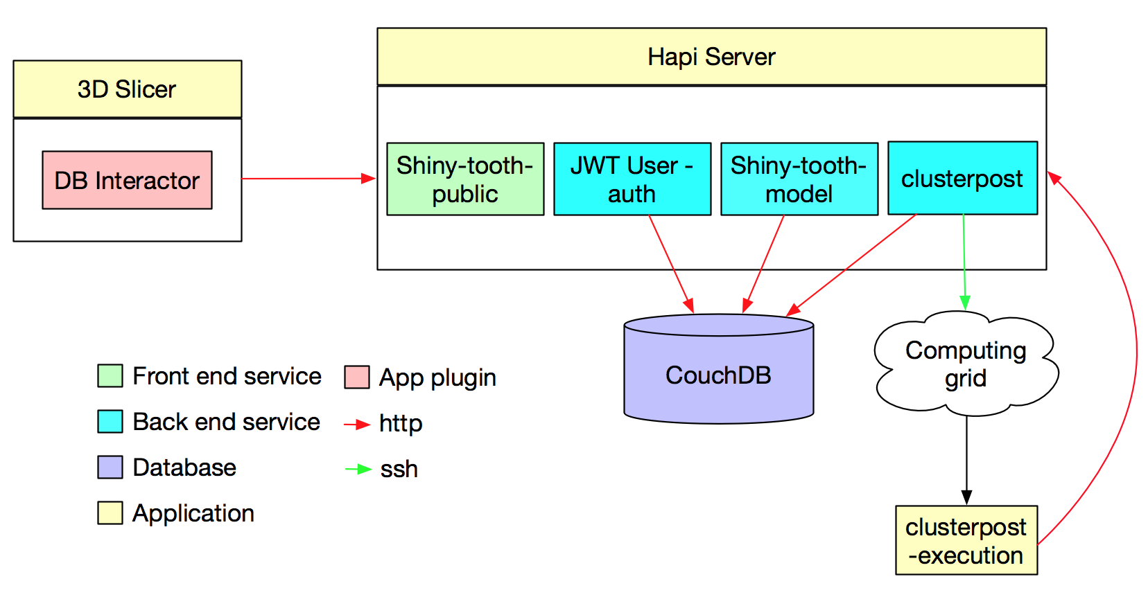
Heterogeneous data repository
Notes:
Representation state transfer. REST'S decoupled architecture, and lighter weight communications between producer and consumer, make REST a popular building style for cloud-based APIs,
Server side application does not need to hold a user session.
Focus on rare diseases
Management of clinical data,
facilitate data sharing across institutions
Keep track of the data from previous experiments.
The ultimate goal is to assure the reproducibility of experiments in the future.

Slide 7
Web app – Clément Mirabel
https://dsci.dent.umich.edu
https://www.slicer.org/wiki/Documentation/Nightly/Modules/DatabaseInteractor

Slide 8
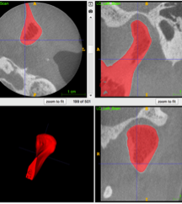
SVA: Shape variation analyzer – Priscille de Dumast
Objective:
Develop a non-invasive technique to provide information about shape changes in TMJ OA.
Classify 3D models into 5 groups generated by consensus between two clinician experts.
Challenges:
Number of training samples
Select appropriate geometric features from the 3D models

Slide 9
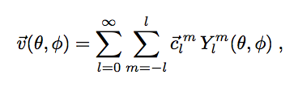
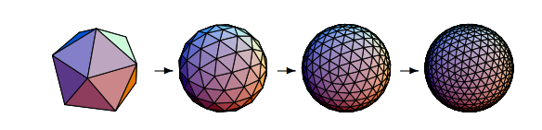
SPHARM-PDM
Can only represent objects of spherical topology
Optimize an equal area mapping of 3D voxel mesh onto the sphere

Slide 10
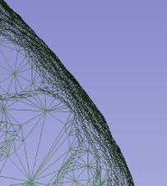
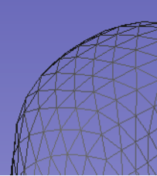
SPHARM-PDM

Slide 11
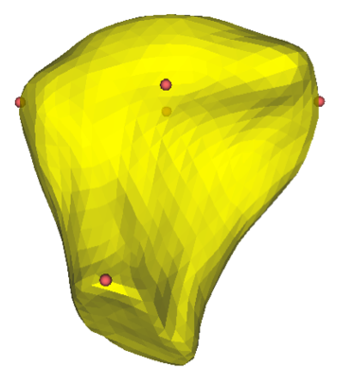
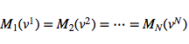
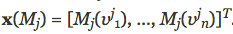
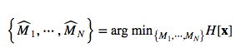
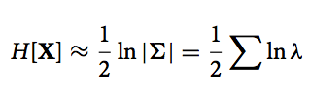
GROUPS
Improve shape correspondence
Entropy terms computed over the landmark distribution
Notes:
M is a continuous mapping functions of correspondences that map surfaces in a common reference space.
X(M_i) is a vector of corresponding points of subject j deformed by M_i
The landmarks are use to constrain the optimization and only those have full correspondence across all cortical surfaces.
Is assumed that x(M_j) are instances of X drawn from a probability density function p(X).
The amount of information in the random sampling is given by the entropy function
For the density estimation, We assume a multivariate Gaussian distribution with covariance Sigma and therefore, the entropy is obtained by H
Lambda are the eigenvalues of Sigma

Slide 12
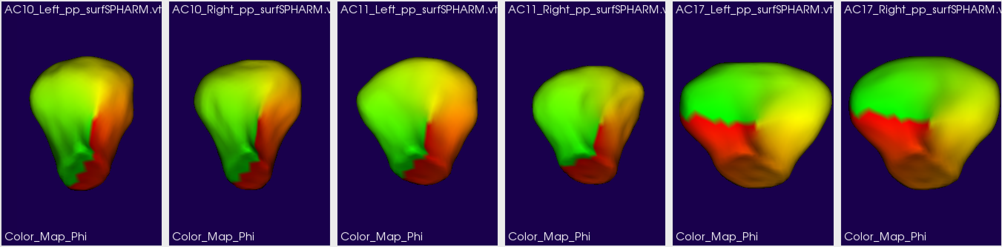
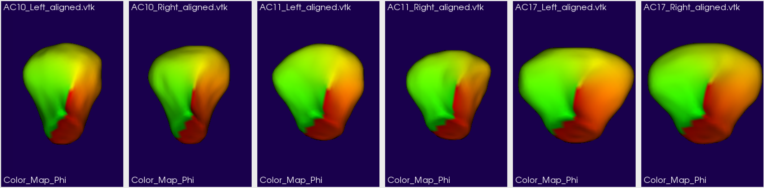
GROUPS – Aligned surfaces

Slide 13
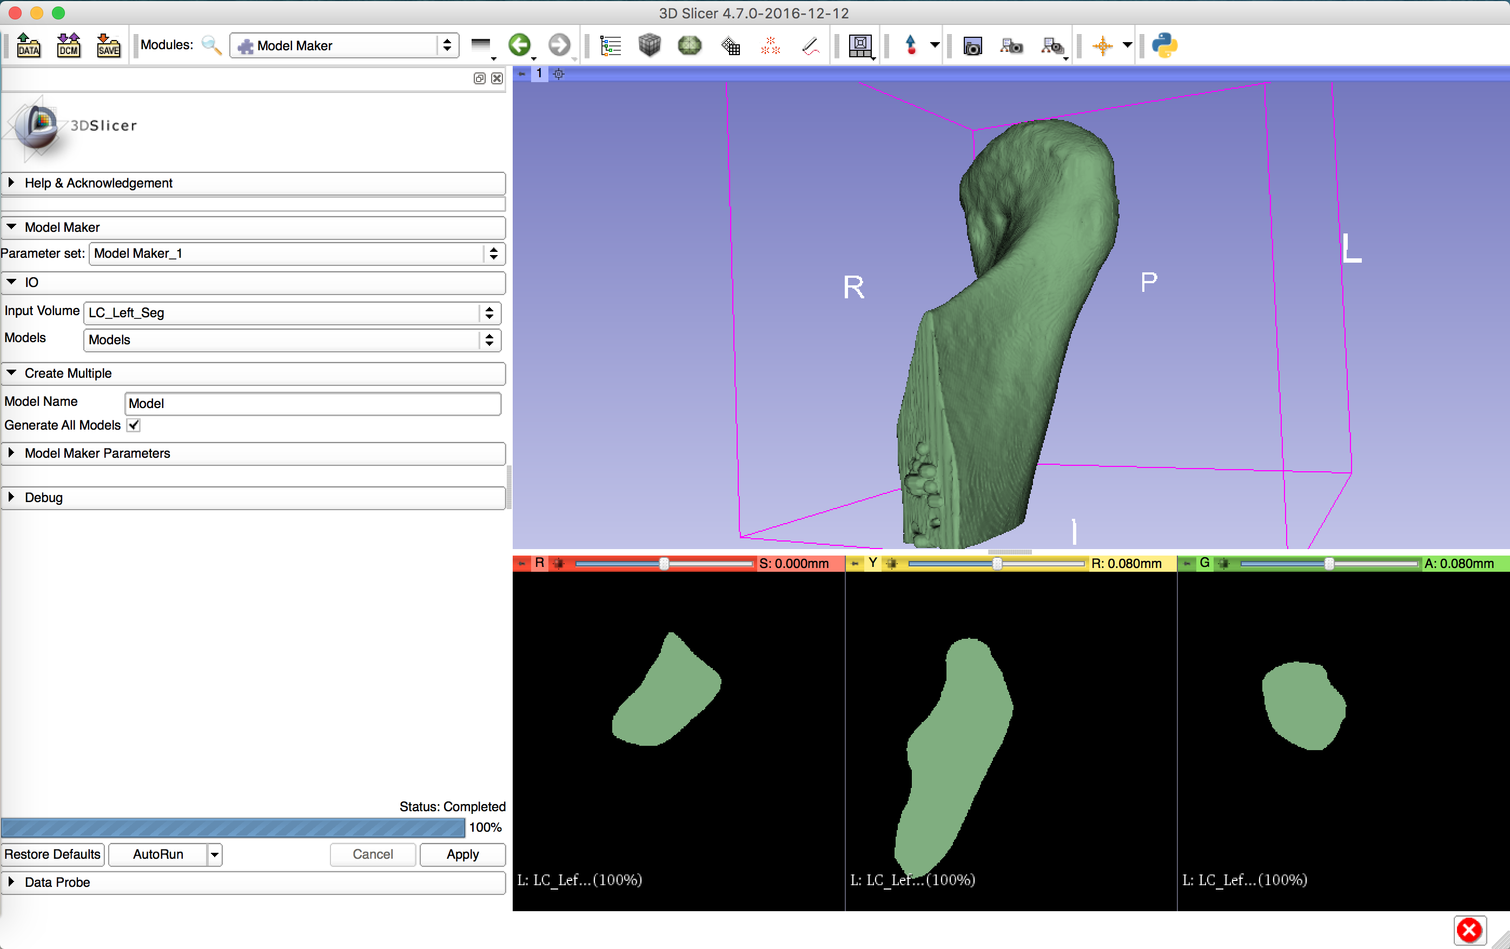
SVA: Shape Variation Analyzer
SVA is new tool to analyze shape variation using deep neural networks.
Learn abstract patterns in the data
Include purely geometric information
Classify condyles in 5 different groups

Slide 14
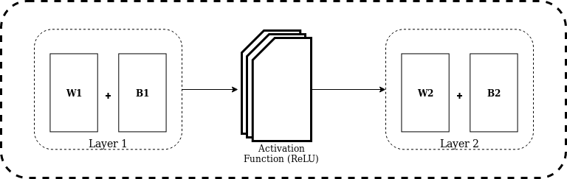

Deep learning classification
Train a network to classify condyles into a category
To balance the classes, simulated data is generated by adding noise to the shapes.
This needs to be improved.

Slide 16
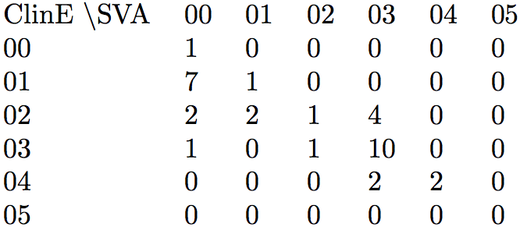
Classification results

Slide 17
Conclusion SVA
SVA is new tool to analyze shape variation using deep neural networks.
The results presented here indicate that using purely geometric features is enough for classification tasks.
This classification approach seems promising and it may help us increase our understanding about shape changes that TMJ OA patients undergo during the course of the disease.
Future work will aim to create a larger data set for training.
Improve how we simulate shapes for each group

Slide 18
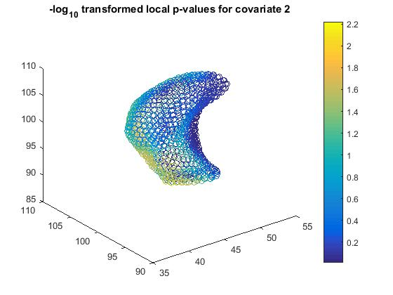
Multivariate Functional Shape Data Analysis (MFSDA) – Chao Huang
Build the association between shape measurements, demographic information and other clinical variables.
Hypothesis testing
Investigate association of covariates of interest and shape.
Cluster based analysis

Slide 19
N_{ij} subject-specific and location-specific
variability
x_{i} is a vector of covariates
d are Nv grid points
β_{ij} is a vector of fixed effects
ε_{ij} are the measurement errors

Slide 20
variable selection
7 pain-related clinical variables (discrete)
1.facialPainRate 2.facialWorstPainRate 3.facialPainAverageRateSixMonths
4.beginPainYears 5.lastMonthDistressedHeadaches
6.lastMonthDistressedMuscleSoreness 7.painLocation
Polychoric correlation matrix
P values
1.00 | 0.78 | 0.80 | 0.57 | 0.43 | 0.54 | 0.64
0.78 | 1.00 | 0.96 | 0.77 | 0.55 | 0.50 | 0.80
0.80 | 0.96 | 1.00 | 0.73 | 0.49 | 0.53 | 0.73
0.57 | 0.77 | 0.73 | 1.00 | 0.57 | 0.60 | 0.64
0.43 | 0.55 | 0.49 | 0.57 | 1.00 | 0.44 | 0.37
0.54 | 0.50 | 0.53 | 0.60 | 0.44 | 1.00 | 0.49
0.64 | 0.80 | 0.73 | 0.64 | 0.37 | 0.49 | 1.00
1.00E+00 | 4.33E-08 | 1.17E-08 | 4.80E-04 | 5.36E-03 | 9.63E-04 | 4.41E-05
4.33E-08 | 1.00E+00 | 2.21E-19 | 1.22E-07 | 7.08E-04 | 2.55E-03 | 1.23E-08
1.17E-08 | 2.21E-19 | 1.00E+00 | 1.10E-06 | 2.11E-03 | 1.31E-03 | 1.09E-06
4.80E-04 | 1.22E-07 | 1.10E-06 | 1.00E+00 | 4.91E-04 | 1.92E-04 | 4.90E-05
5.36E-03 | 7.08E-04 | 2.11E-03 | 4.91E-04 | 1.00E+00 | 5.20E-03 | 1.20E-02
9.63E-04 | 2.55E-03 | 1.31E-03 | 1.92E-04 | 5.20E-03 | 1.00E+00 | 3.40E-03
4.41E-05 | 1.23E-08 | 1.09E-06 | 4.90E-05 | 1.20E-02 | 3.40E-03 | 1.00E+00
Notes:
All the variables are highly correlated with each other !
Here we only inlcude the first covariate into the model

Slide 21
variable selection
8 biological markers in saliva (continuous)
Pearson correlation matrix
P values
1.00 | 0.13 | 0.66 | 0.48 | 0.15 | 0.26 | 0.14 | 0.45
0.13 | 1.00 | 0.43 | 0.36 | 0.54 | 0.26 | -0.15 | 0.15
0.66 | 0.43 | 1.00 | 0.33 | 0.48 | 0.43 | 0.05 | 0.38
0.48 | 0.36 | 0.33 | 1.00 | 0.16 | 0.43 | 0.15 | 0.69
0.15 | 0.54 | 0.48 | 0.16 | 1.00 | 0.32 | 0.11 | 0.15
0.26 | 0.26 | 0.43 | 0.43 | 0.32 | 1.00 | 0.24 | 0.66
0.14 | -0.15 | 0.05 | 0.15 | 0.11 | 0.24 | 1.00 | 0.29
0.45 | 0.15 | 0.38 | 0.69 | 0.15 | 0.66 | 0.29 | 1.00
1.00E+00 | 4.50E-01 | 2.17E-05 | 4.37E-03 | 4.04E-01 | 1.31E-01 | 4.42E-01 | 8.01E-03
4.50E-01 | 1.00E+00 | 1.05E-02 | 3.86E-02 | 8.85E-04 | 1.38E-01 | 4.05E-01 | 4.02E-01
2.17E-05 | 1.05E-02 | 1.00E+00 | 5.37E-02 | 4.48E-03 | 1.10E-02 | 7.94E-01 | 2.86E-02
4.37E-03 | 3.86E-02 | 5.37E-02 | 1.00E+00 | 3.78E-01 | 1.18E-02 | 4.13E-01 | 6.63E-06
4.04E-01 | 8.85E-04 | 4.48E-03 | 3.78E-01 | 1.00E+00 | 6.70E-02 | 5.49E-01 | 4.05E-01
1.31E-01 | 1.38E-01 | 1.10E-02 | 1.18E-02 | 6.70E-02 | 1.00E+00 | 1.75E-01 | 2.00E-05
4.42E-01 | 4.05E-01 | 7.94E-01 | 4.13E-01 | 5.49E-01 | 1.75E-01 | 1.00E+00 | 1.01E-01
8.01E-03 | 4.02E-01 | 2.86E-02 | 6.63E-06 | 4.05E-01 | 2.00E-05 | 1.01E-01 | 1.00E+00
Some variables are highly correlated while some are not ...
One possible way: Principle Component Analysis (PCA)
PCA shows that the percentage of the total variance explained by first principal component is over 98%.

Slide 22
variable selection
8 biological markers in saliva (continuous)
 | Ang | mMP3 | mMP7 | tlMP1 | vECadherin | CXCL16 | eNA78 | vEGF
PC score 1 | 0.150 | 0.545 | 0.478 | 0.157 | 1.000 | 0.319 | 0.107 | 0.149
We find the variable vECadherinSA is highly correlated with the first Principle Component score (Pearson corr. = 1.0, p-value=6.90E-81)
Thus, we include the variable vECadherinSA into the model

Slide 23
variable selection
8 biological markers in plasma (continuous)
Pearson correlation matrix
P values
1.00 | 0.54 | 0.10 | -0.04 | -0.01 | 0.71 | 0.13 | -0.07
0.54 | 1.00 | 0.38 | -0.04 | 0.22 | 0.77 | -0.10 | 0.11
0.10 | 0.38 | 1.00 | 0.05 | 0.31 | 0.33 | 0.25 | 0.08
-0.04 | -0.04 | 0.05 | 1.00 | 0.02 | -0.11 | -0.12 | 0.13
-0.01 | 0.22 | 0.31 | 0.02 | 1.00 | 0.16 | 0.11 | 0.52
0.71 | 0.77 | 0.33 | -0.11 | 0.16 | 1.00 | 0.25 | 0.06
0.13 | -0.10 | 0.25 | -0.12 | 0.11 | 0.25 | 1.00 | 0.18
-0.07 | 0.11 | 0.08 | 0.13 | 0.52 | 0.06 | 0.18 | 1.00
1.00E+00 | 8.74E-04 | 5.85E-01 | 8.33E-01 | 9.74E-01 | 2.23E-06 | 4.79E-01 | 6.94E-01
8.74E-04 | 1.00E+00 | 2.53E-02 | 8.33E-01 | 2.21E-01 | 1.26E-07 | 5.86E-01 | 5.22E-01
5.85E-01 | 2.53E-02 | 1.00E+00 | 7.82E-01 | 7.44E-02 | 5.37E-02 | 1.47E-01 | 6.63E-01
8.33E-01 | 8.33E-01 | 7.82E-01 | 1.00E+00 | 9.08E-01 | 5.25E-01 | 5.06E-01 | 4.62E-01
9.74E-01 | 2.21E-01 | 7.44E-02 | 9.08E-01 | 1.00E+00 | 3.67E-01 | 5.18E-01 | 1.64E-03
2.23E-06 | 1.26E-07 | 5.37E-02 | 5.25E-01 | 3.67E-01 | 1.00E+00 | 1.61E-01 | 7.57E-01
4.79E-01 | 5.86E-01 | 1.47E-01 | 5.06E-01 | 5.18E-01 | 1.61E-01 | 1.00E+00 | 3.07E-01
6.94E-01 | 5.22E-01 | 6.63E-01 | 4.62E-01 | 1.64E-03 | 7.57E-01 | 3.07E-01 | 1.00E+00
Some variables are highly correlated while some are not ...
One possible way: Principle Component Analysis (PCA)
PCA shows that the percentage of the total variance explained by first two principal components is over 99%.

Slide 24
variable selection
8 biological markers in plasma (continuous)
 | Ang | mMP3 | mMP7 | tlMP1 | vECadherin | CXCL16 | eNA78 | vEGF
PC score 1 | 0.034 | 0.285 | 0.333 | 0.018 | 0.997 | 0.213 | 0.106 | 0.518
PC score 2 | 0.559 | 0.959 | 0.305 | -0.046 | -0.071 | 0.739 | -0.129 | -0.036
We find the variable vECadherinP is highly correlated with the first Principle Component score (Pearson corr. = 0.9975, p-value=2.77E-38); the variable mMP3P is highly correlated with the second Principle Component score (Pearson corr. = 0.9586, p-value=5.00E-19)
Thus, we include both vECadherinP and mMP3P into the model

Slide 25
variable selection
7 pain-related clinical variables (discrete)
1.facialPainRate 2.facialWorstPainRate 3.facialPainAverageRateSixMonths
4.beginPainYears 5.lastMonthDistressedHeadaches
6.lastMonthDistressedMuscleSoreness 7.painLocation
Polychoric correlation matrix
P values
1.00 | 0.78 | 0.80 | 0.57 | 0.43 | 0.54 | 0.64
0.78 | 1.00 | 0.96 | 0.77 | 0.55 | 0.50 | 0.80
0.80 | 0.96 | 1.00 | 0.73 | 0.49 | 0.53 | 0.73
0.57 | 0.77 | 0.73 | 1.00 | 0.57 | 0.60 | 0.64
0.43 | 0.55 | 0.49 | 0.57 | 1.00 | 0.44 | 0.37
0.54 | 0.50 | 0.53 | 0.60 | 0.44 | 1.00 | 0.49
0.64 | 0.80 | 0.73 | 0.64 | 0.37 | 0.49 | 1.00
1.00E+00 | 4.33E-08 | 1.17E-08 | 4.80E-04 | 5.36E-03 | 9.63E-04 | 4.41E-05
4.33E-08 | 1.00E+00 | 2.21E-19 | 1.22E-07 | 7.08E-04 | 2.55E-03 | 1.23E-08
1.17E-08 | 2.21E-19 | 1.00E+00 | 1.10E-06 | 2.11E-03 | 1.31E-03 | 1.09E-06
4.80E-04 | 1.22E-07 | 1.10E-06 | 1.00E+00 | 4.91E-04 | 1.92E-04 | 4.90E-05
5.36E-03 | 7.08E-04 | 2.11E-03 | 4.91E-04 | 1.00E+00 | 5.20E-03 | 1.20E-02
9.63E-04 | 2.55E-03 | 1.31E-03 | 1.92E-04 | 5.20E-03 | 1.00E+00 | 3.40E-03
4.41E-05 | 1.23E-08 | 1.09E-06 | 4.90E-05 | 1.20E-02 | 3.40E-03 | 1.00E+00
All the variables are highly correlated with each other !
Here we only inlcude the first covariate into the model

Slide 26
variable selection
8 biological markers in saliva (continuous)
Pearson correlation matrix
P values
1.00 | 0.13 | 0.66 | 0.48 | 0.15 | 0.26 | 0.14 | 0.45
0.13 | 1.00 | 0.43 | 0.36 | 0.54 | 0.26 | -0.15 | 0.15
0.66 | 0.43 | 1.00 | 0.33 | 0.48 | 0.43 | 0.05 | 0.38
0.48 | 0.36 | 0.33 | 1.00 | 0.16 | 0.43 | 0.15 | 0.69
0.15 | 0.54 | 0.48 | 0.16 | 1.00 | 0.32 | 0.11 | 0.15
0.26 | 0.26 | 0.43 | 0.43 | 0.32 | 1.00 | 0.24 | 0.66
0.14 | -0.15 | 0.05 | 0.15 | 0.11 | 0.24 | 1.00 | 0.29
0.45 | 0.15 | 0.38 | 0.69 | 0.15 | 0.66 | 0.29 | 1.00
1.00E+00 | 4.50E-01 | 2.17E-05 | 4.37E-03 | 4.04E-01 | 1.31E-01 | 4.42E-01 | 8.01E-03
4.50E-01 | 1.00E+00 | 1.05E-02 | 3.86E-02 | 8.85E-04 | 1.38E-01 | 4.05E-01 | 4.02E-01
2.17E-05 | 1.05E-02 | 1.00E+00 | 5.37E-02 | 4.48E-03 | 1.10E-02 | 7.94E-01 | 2.86E-02
4.37E-03 | 3.86E-02 | 5.37E-02 | 1.00E+00 | 3.78E-01 | 1.18E-02 | 4.13E-01 | 6.63E-06
4.04E-01 | 8.85E-04 | 4.48E-03 | 3.78E-01 | 1.00E+00 | 6.70E-02 | 5.49E-01 | 4.05E-01
1.31E-01 | 1.38E-01 | 1.10E-02 | 1.18E-02 | 6.70E-02 | 1.00E+00 | 1.75E-01 | 2.00E-05
4.42E-01 | 4.05E-01 | 7.94E-01 | 4.13E-01 | 5.49E-01 | 1.75E-01 | 1.00E+00 | 1.01E-01
8.01E-03 | 4.02E-01 | 2.86E-02 | 6.63E-06 | 4.05E-01 | 2.00E-05 | 1.01E-01 | 1.00E+00
Some variables are highly correlated while some are not ...
One possible way: Principal Component Analysis (PCA)
PCA shows that the percentage of the total variance explained by first principal component is over 98%.
Notes:
Idea: Use partial least squares to describe the corr

Slide 27
variable selection
8 biological markers in saliva (continuous)
 | Ang | mMP3 | mMP7 | tlMP1 | vECadherin | CXCL16 | eNA78 | vEGF
PC score 1 | 0.150 | 0.545 | 0.478 | 0.157 | 1.000 | 0.319 | 0.107 | 0.149
We find the variable vECadherinSA is highly correlated with the first Principle Component score (Pearson corr. = 1.0, p-value=6.90E-81)
Thus, we include the variable vECadherinSA into the model
Notes:
VE-cadherin is a classical cadherin from the cadherin superfamily and the gene is located in a six-cadherin cluster in a region on the long arm of chromosome 16 that is involved in loss of heterozygosity events in breast and prostate cancer. The encoded protein is a calcium-dependent cell–cell adhesion glycoprotein composed of five extracellular cadherin repeats, a transmembrane region and a highly conserved cytoplasmic tail. Functioning as a classic cadherin by imparting to cells the ability to adhere in a homophilic manner, the protein may play an important role in endothelial cell biology through control of the cohesion and organization of the intercellular junctions
Check for scale of variables vECad

Slide 28
variable selection
8 biological markers in plasma (continuous)
Pearson correlation matrix
P values
1.00 | 0.54 | 0.10 | -0.04 | -0.01 | 0.71 | 0.13 | -0.07
0.54 | 1.00 | 0.38 | -0.04 | 0.22 | 0.77 | -0.10 | 0.11
0.10 | 0.38 | 1.00 | 0.05 | 0.31 | 0.33 | 0.25 | 0.08
-0.04 | -0.04 | 0.05 | 1.00 | 0.02 | -0.11 | -0.12 | 0.13
-0.01 | 0.22 | 0.31 | 0.02 | 1.00 | 0.16 | 0.11 | 0.52
0.71 | 0.77 | 0.33 | -0.11 | 0.16 | 1.00 | 0.25 | 0.06
0.13 | -0.10 | 0.25 | -0.12 | 0.11 | 0.25 | 1.00 | 0.18
-0.07 | 0.11 | 0.08 | 0.13 | 0.52 | 0.06 | 0.18 | 1.00
1.00E+00 | 8.74E-04 | 5.85E-01 | 8.33E-01 | 9.74E-01 | 2.23E-06 | 4.79E-01 | 6.94E-01
8.74E-04 | 1.00E+00 | 2.53E-02 | 8.33E-01 | 2.21E-01 | 1.26E-07 | 5.86E-01 | 5.22E-01
5.85E-01 | 2.53E-02 | 1.00E+00 | 7.82E-01 | 7.44E-02 | 5.37E-02 | 1.47E-01 | 6.63E-01
8.33E-01 | 8.33E-01 | 7.82E-01 | 1.00E+00 | 9.08E-01 | 5.25E-01 | 5.06E-01 | 4.62E-01
9.74E-01 | 2.21E-01 | 7.44E-02 | 9.08E-01 | 1.00E+00 | 3.67E-01 | 5.18E-01 | 1.64E-03
2.23E-06 | 1.26E-07 | 5.37E-02 | 5.25E-01 | 3.67E-01 | 1.00E+00 | 1.61E-01 | 7.57E-01
4.79E-01 | 5.86E-01 | 1.47E-01 | 5.06E-01 | 5.18E-01 | 1.61E-01 | 1.00E+00 | 3.07E-01
6.94E-01 | 5.22E-01 | 6.63E-01 | 4.62E-01 | 1.64E-03 | 7.57E-01 | 3.07E-01 | 1.00E+00
Some variables are highly correlated while some are not ...
One possible way: Principle Component Analysis (PCA)
PCA shows that the percentage of the total variance explained by first two principal components is over 99%.

Slide 29
variable selection
8 biological markers in plasma (continuous)
 | Ang | mMP3 | mMP7 | tlMP1 | vECadherin | CXCL16 | eNA78 | vEGF
PC score 1 | 0.034 | 0.285 | 0.333 | 0.018 | 0.997 | 0.213 | 0.106 | 0.518
PC score 2 | 0.559 | 0.959 | 0.305 | -0.046 | -0.071 | 0.739 | -0.129 | -0.036
We find the variable vECadherinP is highly correlated with the first Principle Component score (Pearson corr. = 0.9975, p-value=2.77E-38); the variable mMP3P is highly correlated with the second Principle Component score (Pearson corr. = 0.9586, p-value=5.00E-19)
Thus, we include both vECadherinP and mMP3P into the model

Slide 30
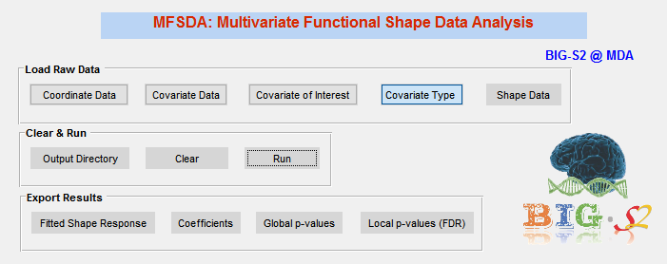
Multivariate Varying Coefficient Model for Shape Data

Slide 31
Result
Covariate | Global p-value | Clustering p-value
Group | 0.012 | 0.028
Age | 0.050 | 0.022
Sex | 0.066 | 0.070
Facial pain rate | 0.046 | 0.050
vECadherin SA | 0.214 | 0.172
mMP3 P | 0.248 | 0.252
vECadherin P | 0.046 | 0.050

Slide 32
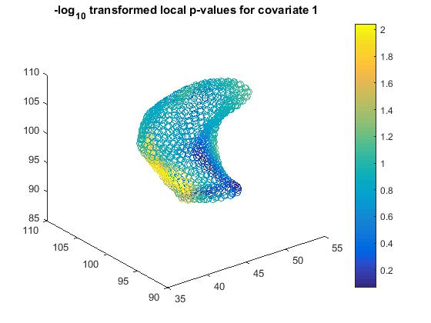
Local P-values (Group)

Slide 33
Local P-values (Age)

Slide 34
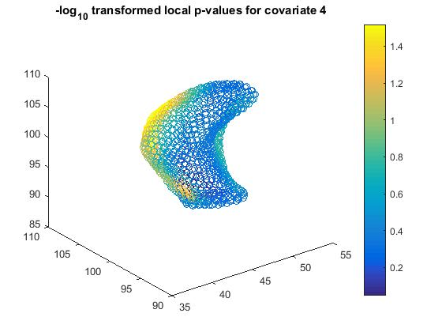
Local P-values (Facial pain rate)

Slide 35
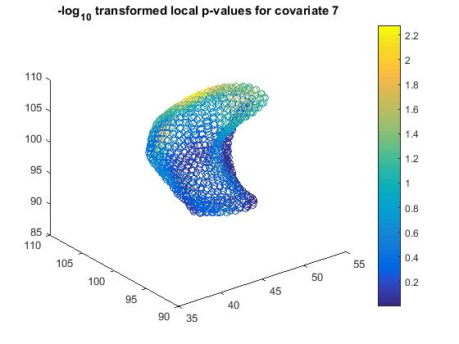
Local P-values (vECadherinP)

Slide 36
Analysis on Normal

Slide 37
variable selection
7 pain-related clinical variables (discrete)
1.facialPainRate 2.facialWorstPainRate 3.facialPainAverageRateSixMonths
4.beginPainYears 5.lastMonthDistressedHeadaches
6.lastMonthDistressedMuscleSoreness 7.painLocation
For all the 7 variables, most observations are zeros except the variable last Month Distressed Headaches. Thus, we only include this one into the model.

Slide 38
variable selection
8 biological markers in saliva (continuous)
Pearson correlation matrix
P values
1.00 | 0.07 | 0.74 | 0.51 | 0.42 | 0.67 | 0.20 | 0.41
0.07 | 1.00 | 0.32 | 0.46 | -0.07 | 0.41 | -0.21 | 0.16
0.74 | 0.32 | 1.00 | 0.53 | 0.35 | 0.71 | -0.07 | 0.33
0.51 | 0.46 | 0.53 | 1.00 | 0.26 | 0.69 | 0.17 | 0.69
0.42 | -0.07 | 0.35 | 0.26 | 1.00 | 0.19 | 0.56 | 0.16
0.67 | 0.41 | 0.71 | 0.69 | 0.19 | 1.00 | 0.06 | 0.69
0.20 | -0.21 | -0.07 | 0.17 | 0.56 | 0.06 | 1.00 | 0.23
0.41 | 0.16 | 0.33 | 0.69 | 0.16 | 0.69 | 0.23 | 1.00
1.00 | 0.78 | 0.00 | 0.04 | 0.09 | 0.00 | 0.44 | 0.10
0.78 | 1.00 | 0.20 | 0.06 | 0.80 | 0.10 | 0.41 | 0.55
0.00 | 0.20 | 1.00 | 0.03 | 0.17 | 0.00 | 0.80 | 0.19
0.04 | 0.06 | 0.03 | 1.00 | 0.31 | 0.00 | 0.52 | 0.00
0.09 | 0.80 | 0.17 | 0.31 | 1.00 | 0.46 | 0.02 | 0.54
0.00 | 0.10 | 0.00 | 0.00 | 0.46 | 1.00 | 0.82 | 0.00
0.44 | 0.41 | 0.80 | 0.52 | 0.02 | 0.82 | 1.00 | 0.37
0.10 | 0.55 | 0.19 | 0.00 | 0.54 | 0.00 | 0.37 | 1.00
Some variables are highly correlated while some are not ...
One possible way: Principle Component Analysis (PCA)
PCA shows that the percentage of the total variance explained by first two principal components is over 88%.

Slide 39
variable selection
8 biological markers in saliva (continuous)
 | Ang | mMP3 | mMP7 | tlMP1 | vECadherin | CXCL16 | eNA78 | vEGF
PC score 1 | 0.467 | -0.063 | 0.385 | 0.312 | 0.989 | 0.248 | 0.657 | 0.214
PC score 2 | 0.489 | 0.488 | 0.850 | 0.406 | 0.022 | 0.578 | -0.564 | 0.174
We find the variable vECadherinSA is highly correlated with the first Principle Component score (Pearson corr. = 0.989, p-value=7.99E-14); and the variable mMP7SA is highly correlated with the second Principle Component score (Pearson corr. = 0.850, p-value=1.54E-5)
Thus, we include these two variables into the model

Slide 40
variable selection
8 biological markers in plasma (continuous)
Pearson correlation matrix
P values
1.00 | 0.65 | 0.10 | -0.12 | 0.27 | 0.75 | -0.04 | -0.11
0.65 | 1.00 | 0.12 | 0.00 | 0.49 | 0.85 | -0.21 | 0.20
0.10 | 0.12 | 1.00 | -0.21 | 0.05 | 0.35 | -0.04 | 0.04
-0.12 | 0.00 | -0.21 | 1.00 | -0.13 | -0.19 | -0.36 | 0.43
0.27 | 0.49 | 0.05 | -0.13 | 1.00 | 0.44 | -0.02 | 0.54
0.75 | 0.85 | 0.35 | -0.19 | 0.44 | 1.00 | 0.15 | 0.04
-0.04 | -0.21 | -0.04 | -0.36 | -0.02 | 0.15 | 1.00 | -0.12
-0.11 | 0.20 | 0.04 | 0.43 | 0.54 | 0.04 | -0.12 | 1.00
1.00 | 0.00 | 0.71 | 0.64 | 0.30 | 0.00 | 0.89 | 0.67
0.00 | 1.00 | 0.64 | 1.00 | 0.05 | 0.00 | 0.42 | 0.44
0.71 | 0.64 | 1.00 | 0.43 | 0.86 | 0.16 | 0.88 | 0.87
0.64 | 1.00 | 0.43 | 1.00 | 0.61 | 0.47 | 0.16 | 0.08
0.30 | 0.05 | 0.86 | 0.61 | 1.00 | 0.08 | 0.93 | 0.02
0.00 | 0.00 | 0.16 | 0.47 | 0.08 | 1.00 | 0.57 | 0.87
0.89 | 0.42 | 0.88 | 0.16 | 0.93 | 0.57 | 1.00 | 0.65
0.67 | 0.44 | 0.87 | 0.08 | 0.02 | 0.87 | 0.65 | 1.00
Some variables are highly correlated while some are not ...
One possible way: Principle Component Analysis (PCA)
PCA shows that the percentage of the total variance explained by first two principal components is over 99%.

Slide 41
variable selection
8 biological markers in plasma (continuous)
 | Ang | mMP3 | mMP7 | tlMP1 | vECadherin | CXCL16 | eNA78 | vEGF
PC score 1 | 0.383 | 0.652 | 0.071 | -0.117 | 0.979 | 0.575 | -0.067 | 0.515
PC score 2 | 0.526 | 0.758 | 0.104 | 0.100 | -0.203 | 0.629 | -0.216 | -0.177
We find the variable vECadherinP is highly correlated with the first Principle Component score (Pearson corr. = 0.979, p-value=8.42E-12); the variable mMP3P is highly correlated with the second Principle Component score (Pearson corr. = 0.758, p-value=4.24E-4)
Thus, we include both vECadherinP and mMP3P into the model

Slide 42
Multivariate Varying Coefficient Model for Shape Data

Slide 43
Result
Covariate | Global p-value | Clustering p-value
Age | 0.161 | 0.110
Sex | 0.103 | 0.120
last Month Distressed Headaches | 0.352 | 0.056
mMP7SA | 2.42E-5 | 0.004
vECadherin SA | 0.097 | 0.058
mMP3 P | 0.274 | 0.110
vECadherin P | 0.033 | 0.028

Slide 44
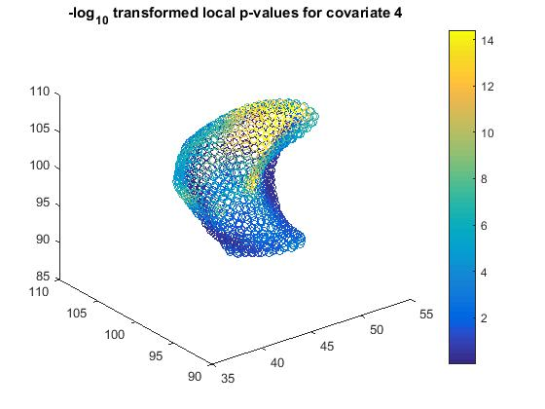
Local P-values (last Month Distressed Headaches)

Slide 45
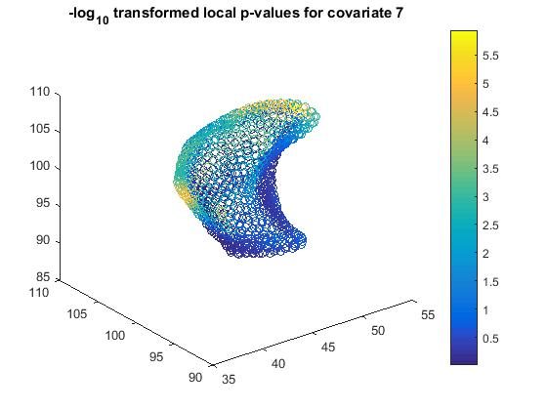
Local P-values (vECadherin P)

Slide 46
Analysis on OA

Slide 47
variable selection
7 pain-related clinical variables (discrete)
1.facialPainRate 2.facialWorstPainRate 3.facialPainAverageRateSixMonths
4.beginPainYears 5.lastMonthDistressedHeadaches
6.lastMonthDistressedMuscleSoreness 7.painLocation
Pearson correlation matrix
P values
1.00 | 0.57 | 0.61 | 0.20 | 0.17 | 0.37 | 0.11
0.57 | 1.00 | 0.90 | 0.46 | 0.39 | 0.19 | -0.06
0.61 | 0.90 | 1.00 | 0.40 | 0.23 | 0.29 | -0.05
0.20 | 0.46 | 0.40 | 1.00 | 0.44 | 0.46 | 0.00
0.17 | 0.39 | 0.23 | 0.44 | 1.00 | 0.31 | -0.29
0.37 | 0.19 | 0.29 | 0.46 | 0.31 | 1.00 | 0.13
0.11 | -0.06 | -0.05 | 0.00 | -0.29 | 0.13 | 1.00
1.00 | 0.02 | 0.01 | 0.43 | 0.51 | 0.14 | 0.67
0.02 | 1.00 | 0.00 | 0.06 | 0.12 | 0.46 | 0.83
0.01 | 0.00 | 1.00 | 0.11 | 0.36 | 0.25 | 0.85
0.43 | 0.06 | 0.11 | 1.00 | 0.08 | 0.06 | 0.99
0.51 | 0.12 | 0.36 | 0.08 | 1.00 | 0.23 | 0.26
0.14 | 0.46 | 0.25 | 0.06 | 0.23 | 1.00 | 0.62
0.67 | 0.83 | 0.85 | 0.99 | 0.26 | 0.62 | 1.00
Some variables are highly correlated while some are not ...
One possible way: Principle Component Analysis (PCA)
PCA shows that the percentage of the total variance explained by first two principal components is over 82%.

Slide 48
variable selection
7 pain-related clinical variables (discrete)
 | Var_1 | Var_2 | Var_3 | Var_4 | Var_5 | Var_6 | Var_7
PC score 1 | 0.616 | 0.905 | 0.889 | 0.743 | 0.440 | 0.433 | -0.024
PC score 2 | -0.413 | -0.303 | -0.388 | 0.666 | 0.233 | 0.238 | 0.010
We find the variable facial Worst Pain Rate is highly correlated with the first Principle Component score (Pearson corr. = 0.905, p-value=6.08E-7); and the variable begin Pain Years is highly correlated with the second Principle Component score (Pearson corr. = 0.666, p-value=0.0035)
Thus, we include these two variables into the model

Slide 49
variable selection
8 biological markers in saliva (continuous)
Pearson correlation matrix
P values
1.00 | 0.22 | 0.60 | 0.45 | 0.16 | 0.16 | 0.05 | 0.49
0.22 | 1.00 | 0.60 | 0.22 | 0.99 | 0.30 | 0.08 | 0.18
0.60 | 0.60 | 1.00 | 0.15 | 0.60 | 0.38 | 0.29 | 0.41
0.45 | 0.22 | 0.15 | 1.00 | 0.18 | 0.39 | 0.09 | 0.70
0.16 | 0.99 | 0.60 | 0.18 | 1.00 | 0.30 | 0.08 | 0.13
0.16 | 0.30 | 0.38 | 0.39 | 0.30 | 1.00 | 0.56 | 0.69
0.05 | 0.08 | 0.29 | 0.09 | 0.08 | 0.56 | 1.00 | 0.43
0.49 | 0.18 | 0.41 | 0.70 | 0.13 | 0.69 | 0.43 | 1.00
1.00 | 0.39 | 0.01 | 0.07 | 0.54 | 0.53 | 0.85 | 0.05
0.39 | 1.00 | 0.01 | 0.40 | 0.00 | 0.25 | 0.77 | 0.50
0.01 | 0.01 | 1.00 | 0.55 | 0.01 | 0.13 | 0.27 | 0.11
0.07 | 0.40 | 0.55 | 1.00 | 0.48 | 0.12 | 0.74 | 0.00
0.54 | 0.00 | 0.01 | 0.48 | 1.00 | 0.24 | 0.77 | 0.61
0.53 | 0.25 | 0.13 | 0.12 | 0.24 | 1.00 | 0.02 | 0.00
0.85 | 0.77 | 0.27 | 0.74 | 0.77 | 0.02 | 1.00 | 0.08
0.05 | 0.50 | 0.11 | 0.00 | 0.61 | 0.00 | 0.08 | 1.00
Some variables are highly correlated while some are not ...
One possible way: Principle Component Analysis (PCA)
PCA shows that the percentage of the total variance explained by first principal component is over 99%.

Slide 50
variable selection
8 biological markers in saliva (continuous)
 | Cov | mMP3 | mMP7 | tlMP1 | vECadherin | CXCL16 | eNA78 | vEGF
PC score 1 | 0.159 | 0.988 | 0.602 | 0.185 | 1.000 | 0.301 | 0.076 | 0.134
We find the variable vECadherinSA is highly correlated with the first Principle Component score (Pearson corr. = 1.00, p-value=1.71E-41
Thus, we include this variable into the model

Slide 51
variable selection
8 biological markers in plasma (continuous)
Pearson correlation matrix
P values
1.00 | 0.39 | 0.19 | 0.04 | -0.36 | 0.56 | 0.41 | -0.06
0.39 | 1.00 | 0.60 | -0.10 | -0.03 | 0.71 | 0.02 | 0.06
0.19 | 0.60 | 1.00 | 0.28 | 0.41 | 0.55 | 0.38 | 0.09
0.04 | -0.10 | 0.28 | 1.00 | 0.21 | -0.13 | 0.18 | -0.12
-0.36 | -0.03 | 0.41 | 0.21 | 1.00 | -0.14 | 0.21 | 0.52
0.56 | 0.71 | 0.55 | -0.13 | -0.14 | 1.00 | 0.47 | 0.07
0.41 | 0.02 | 0.38 | 0.18 | 0.21 | 0.47 | 1.00 | 0.35
-0.06 | 0.06 | 0.09 | -0.12 | 0.52 | 0.07 | 0.35 | 1.00
1.00 | 0.13 | 0.46 | 0.87 | 0.15 | 0.02 | 0.10 | 0.82
0.13 | 1.00 | 0.01 | 0.71 | 0.91 | 0.00 | 0.95 | 0.83
0.46 | 0.01 | 1.00 | 0.28 | 0.10 | 0.02 | 0.13 | 0.72
0.87 | 0.71 | 0.28 | 1.00 | 0.41 | 0.61 | 0.50 | 0.65
0.15 | 0.91 | 0.10 | 0.41 | 1.00 | 0.59 | 0.43 | 0.03
0.02 | 0.00 | 0.02 | 0.61 | 0.59 | 1.00 | 0.06 | 0.78
0.10 | 0.95 | 0.13 | 0.50 | 0.43 | 0.06 | 1.00 | 0.17
0.82 | 0.83 | 0.72 | 0.65 | 0.03 | 0.78 | 0.17 | 1.00
Some variables are highly correlated while some are not ...
One possible way: Principle Component Analysis (PCA)
PCA shows that the percentage of the total variance explained by first two principal components is over 99%.

Slide 52
variable selection
8 biological markers in plasma (continuous)
 | Ang | mMP3 | mMP7 | tlMP1 | vECadherin | CXCL16 | eNA78 | vEGF
PC score 1 | -0.366 | -0.034 | 0.411 | 0.215 | 1.000 | -0.143 | 0.207 | 0.516
PC score 2 | 0.377 | 0.999 | 0.618 | -0.088 | 0.005 | 0.712 | 0.031 | 0.073
We find the variable vECadherinP is highly correlated with the first Principle Component score (Pearson corr. = 1.000, p-value=5.84E-36); the variable mMP3P is highly correlated with the second Principle Component score (Pearson corr. = 0.758, p-value=5.35E-23)
Thus, we include both vECadherinP and mMP3P into the model

Slide 53
Multivariate Varying Coefficient Model for Shape Data

Slide 54
Result
Covariate | Global p-value | Clustering p-value
Age | 0.133 | 0.092
Sex | 0.031 | 0.024
facial Worst Pain Rate | 0.031 | 0.084
begin Pain Years | 0.040 | 0.054
vECadherin SA | 0.027 | 0.050
mMP3 P | 0.107 | 0.068
vECadherin P | 0.001 | 0.018

Slide 55

Local P-values (Sex)

Slide 56
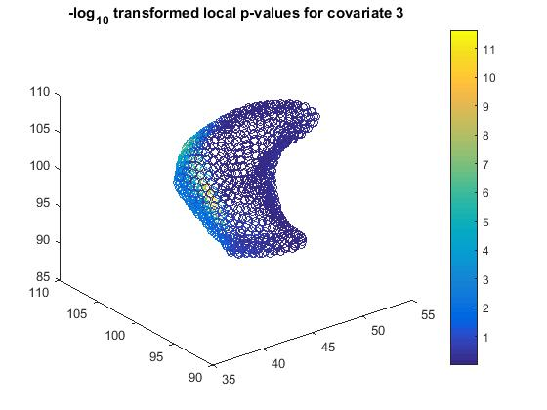
Local P-values (facial Worst Pain Rate)

Slide 57
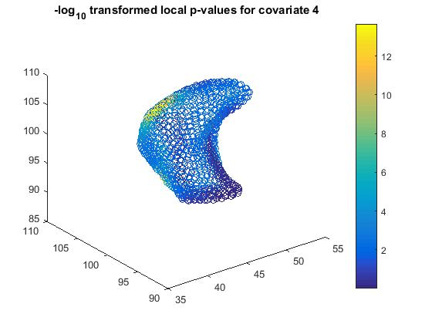
Local P-values (begin Pain Years)

Slide 58
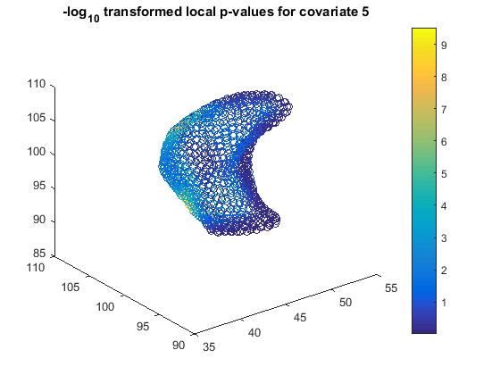
Local P-values (vECadherinSA)

Slide 59
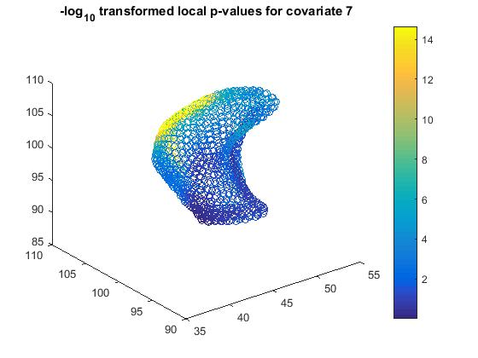
Local P-values (vECadherinP)

